Slide 1
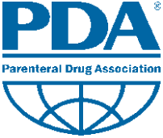

Slide 2
Data Integrity, Quality Culture and TR 84
PDA Mountain States Chapter
Monday, May 15, 2023
Presenter: Sue Schniepp
2018 © Regulatory Compliance Associates Inc.

Slide 3
Topics
Data Integrity Concepts
History
Culture Impact
TR 84
2018 © Regulatory Compliance Associates Inc.

Slide 4
What is Data Integrity?
“Data integrity is the assurance that data records are accurate, complete, intact and maintained within their original context, including their relationship to other data records. This definition applies to data recorded in electronic and paper formats or a hybrid of both.”
“…integrity denotes validity.”
“Ensuring data integrity means protecting original data from accidental or intentional modification, falsification or even deletion, which is the key to reliable and trustworthy records that will withstand scrutiny during regulatory inspections.”
Excerpt From regulatoryfocus.org April 2014
2018 © Regulatory Compliance Associates Inc.

Slide 5
ALCOA
Data Integrity Element | Description | 21 CFR Reference
Attributable | All data generated or collected must be attributable to the person generating the data | §§ 211.101(d), 211.122, 211.186, 211.188(b)(11), and 212.50(c)(10)
Legible | All data recorded must be legible (readable) and permanent | §§ 211.180(e) and 212.110(b)
Contemporaneous | results, measurements and data is recorded at the time the work is performed | §§ 211.100(b) and 211.160(a)
Original | Original data, sometimes referred to as source data or primary data, is the medium in which the data point is recorded for the first time. | §§ 211.180 and 211.194(a)
Accurate | complete, consistent, truthful, and representative of facts | §§ 211.22(a), 211.68, 211.188, and 212.60(g)
2018 © Regulatory Compliance Associates Inc.

Slide 6
ALCOA+
Attributable, Legible, Contemporaneous, Original, Accurate plus:
Complete: Information that is critical to recreating and understanding an event. This would include any repeat or reanalysis performed on a laboratory test sample.
Consistent: The data are presented, recorded, dated, or time-stamped in the expected and defined sequence.
Enduring: The data or information must be maintained, intact, and accessible throughout their defined retention period.
Available: The data or information must be able to be accessed at any time during the defined retention period.
Annex 5 Guidance on good data and record management practices
Appendix 1
Expectations and examples of special risk management considerations for the implementation of ALCOA (-plus) principles in paper-based and electronic systems

Slide 7
What is Data Integrity? (cont’)
Example of Data Integrity Violations
Fabricating Data
Backdating
Presenting Existing Data as New Data
Reporting Only Passing Values
Testing into Compliance by Re-running Samples Until Results Pass
Discarding/Altering Data (Electronic or Hard Copy)
Reported Values Not Supported by Raw Data
Forging and/or Unauthorized Signatures
Not Recording Activities Real-time
2018 © Regulatory Compliance Associates Inc.

Slide 8
What’s Going On Out There?
2018 © Regulatory Compliance Associates Inc.

Slide 9
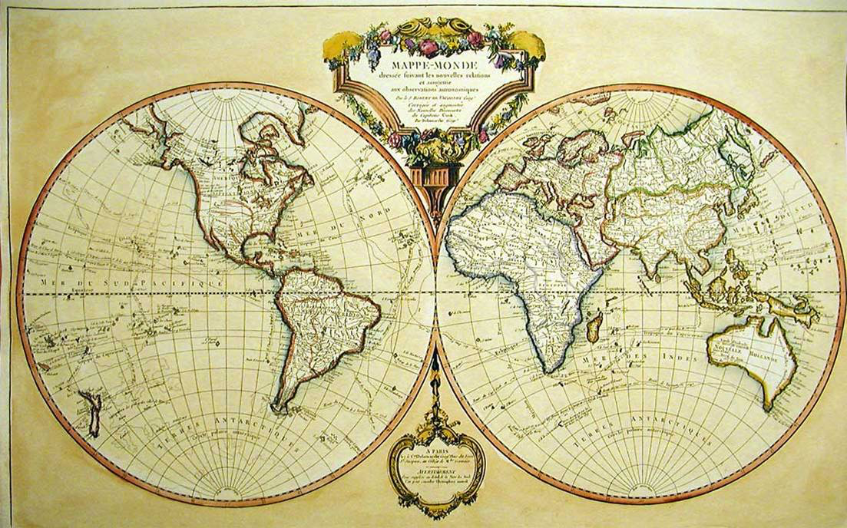
History
“Progress, far from consisting in change, depends on retentiveness. Those who cannot remember the past are condemned to repeat it.”
George Santayana (1863—1952)
2018 © Regulatory Compliance Associates Inc.

Slide 10
Significant Events
1989 – Generic Drug Scandal
“several manufacturers had falsified data submitted in seeking FDA authorization to market certain generic drugs”
1993 – The Barr Decision
“The reported problems include misplaced records, test data recorded on scrap paper, failure to control manufacturing steps such as those governing products' physical properties, release of products not meeting their specifications, inadequate investigation of failed products, and failure to validate test methods and manufacturing processes, including cleaning processes.”
1990 – 2003 – Issuance of Consent Decrees
“Of the more than 25 consent decrees issued between 1990 and 2003, only one or two firms have been removed from their decrees.”
2018 © Regulatory Compliance Associates Inc.

Slide 11
Significant Events (cont’)
2005 – The Case of Able Labs
“Able Laboratories recalled all of its prescription drugs in one of the USAs largest drug recalls.” & “…failed to tell regulators when drugs failed quality tests and sometimes substituted failing with passing results.” & “The substitutions involved "cutting and pasting" computer records and were done by supervisors and lab analysts, the report says.”
2013 – Ranbaxy
“The fraud, investigated over eight years by US authorities, was brought to light by a whistle-blowing ex-employee, who said Ranbaxy created ‘a complicated trail of falsified records and dangerous manufacturing practices.’ ”
2019 - AveXis 483
“It was alleged that two senior executives altered or instructed others to alter small amount of raw data…”
Response: “…ensure a robust culture of quality…”
2018 © Regulatory Compliance Associates Inc.

Slide 12
Warning Letters
“the investigator noticed that during an inspection of the packaging area for (b)(4) # (b)(4) a production employee had recorded the final packed quantity of the batch in Step (b)(4), even though the quantity was not yet known because the operator had not yet weighed the batch.”
“For example, the batch record includes information that indicates citric acid was added during the initial manufacture of the batch; however, an investigation report conducted by the firm alleges that citric acid was not initially added to this batch. In addition, there is no indication within the batch record that the batch was reprocessed and the citric acid added at a later time.”
2018 © Regulatory Compliance Associates Inc.

Slide 13
Warning Letters (cont’)
“FDA investigators identified instances of non-contemporaneous documentation of batch production activities. Two uncontrolled Excel spreadsheets were used to record discrepancies and certain in-process drug quality data. This data was initially missing in the batch manufacturing record. Your firm later entered this data into batch records and backdated them.”
2018 © Regulatory Compliance Associates Inc.

Slide 14
Warning Letters (cont’)
Prior to conducting official analyses, your quality control laboratory performed “experimental” analyses on product batches to assess whether your API met specifications, but failed to document these “experimental” tests in official laboratory records or to justify their exclusion. Our investigator found the results of 2,404 high performance liquid chromatography (HPLC) injections in a folder titled “Experimental” on instrument SZG-002-006l. Your quality unit indicated that these “experimental” injections were being conducted in all (b)(4) chromatographic units in your quality control laboratory. Your management provided different explanations in an attempt to justify the practice, including “fear” that the sample results would not pass.
2018 © Regulatory Compliance Associates Inc.

Slide 15
2018 © Regulatory Compliance Associates Inc.

Slide 16
Industry Changes
Emergence of Generic Industry
Emergence of Biosimilars
Emergence of Virtual Companies
Emergence of CMOs
Emergence of Compounding Pharmacies & 503b Outsourcing Facilities
Institutional Knowledge Lost through M&A
Emergence of Information Technology
2018 © Regulatory Compliance Associates Inc.

Slide 17
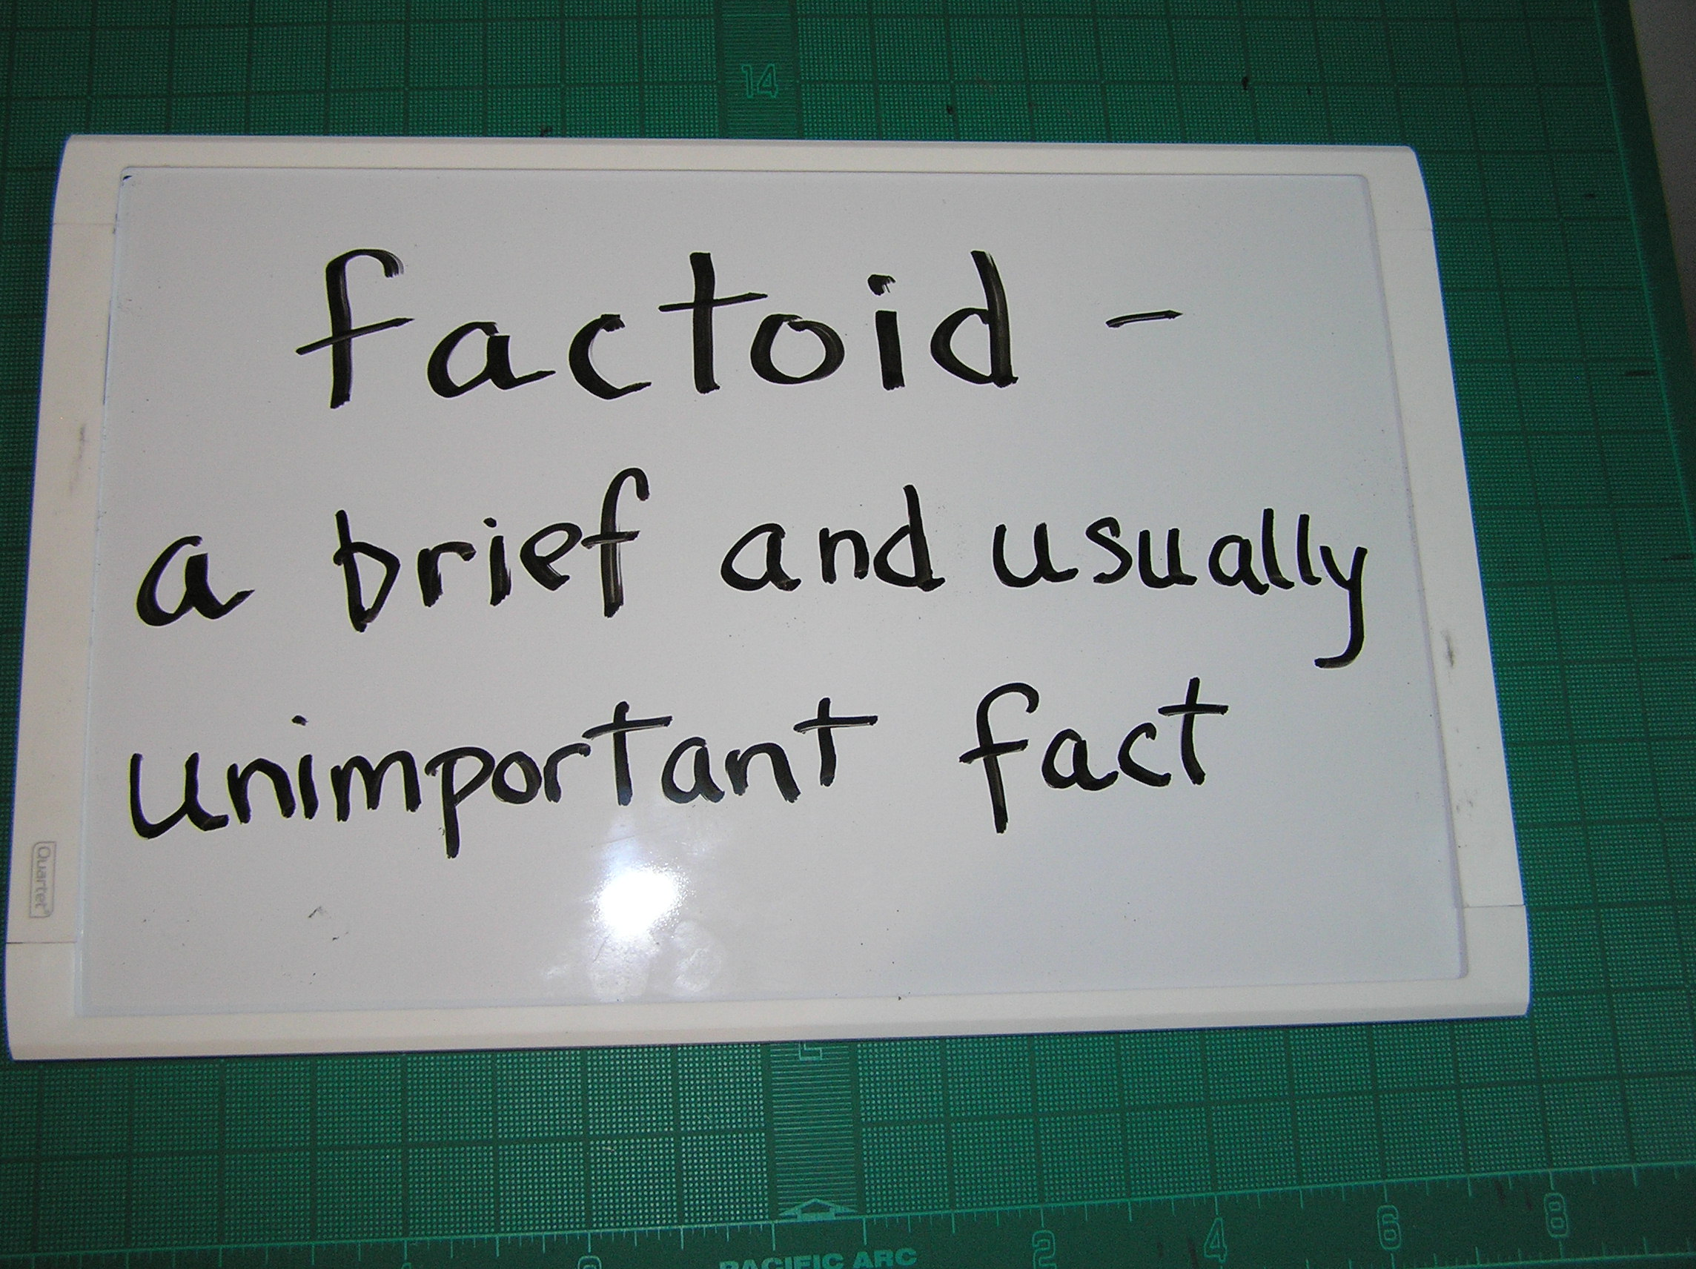
Interesting Factoids
Between 2005 and 2016 there were ≈225 Warning Letters Issued for “Data Integrity”
In 2002 at the International GMP Symposium Issues of Concern Were:
Improper documentation
Lack of Thorough Investigations
Insufficient Training
2018 © Regulatory Compliance Associates Inc.

Slide 18
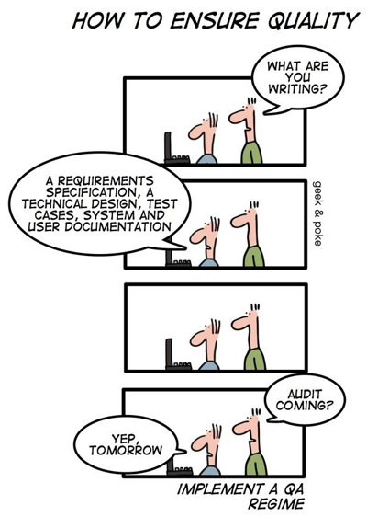
What does Quality Culture Have to do with Data Integrity?

Slide 19
A maximally efficient, agile, flexible, pharmaceutical manufacturing sector that reliably produces high quality drug products without extensive regulatory oversight.
Janet Woodcock,FDA,Center for Drug Evaluation and Research October 5,2005

Slide 20
PIC/S: Good Practices for Data Management and Integrity in Regulated GMP/GDP Environments
6.3 Quality Culture
Management should aim to create a work environment (i.e. quality culture) that is transparent and open, one in which personnel are encouraged to freely communicate failures and mistakes. Organisational reporting structure should permit the information flow between personnel at all levels.

Slide 21
MHRA ‘GXP’ Data Integrity Guidance and Definitions
3. The principles of data integrity
3.1 The organisation needs to take responsibility for the systems used and the data they generate. The organisational culture should ensure data is complete, consistent and accurate in all its forms, i.e. paper and electronic.
3.3 The impact of organisational culture, the behaviour driven by performance indicators, objectives and senior management behaviour on the success of data governance measures should not be underestimated. The data governance policy (or equivalent) should be endorsed at the highest levels of the organisation.

Slide 22
World Health Organization: Guidance on good data and record management practices
1. Introduction
1.4 Examples of controls that may require development and strengthening to ensure good data management strategies include, but are not limited to:
adoption of a quality culture within the company that encourages personnel to be transparent about failures so that management has an accurate understanding of risks and can then provide the necessary resources to achieve expectations and meet data quality standards:

Slide 23
World Health Organization: Guidance on good data and record management practices
4. Principles
4.7 Quality culture. Management, with the support of the quality unit, should establish and maintain a working environment that minimizes the risk of non-compliant records and erroneous records and data. An essential element of the quality culture is the transparent and open reporting of deviations, errors, omissions and aberrant results at all levels of the organization, irrespective of hierarchy. Steps should be taken to prevent, and to detect and correct weaknesses in systems and procedures that may lead to data errors so as to continually improve the robustness of scientific decision-making within the organization. Senior management should actively discourage any management practices that might reasonably be expected to inhibit the active and complete reporting of such issues, for example, hierarchical constraints and blame cultures.

Slide 24
Data Integrity and Compliance With Drug CGMP
Questions and Answers
Guidance for Industry
Meaningful and effective strategies should consider the design, operation, and monitoring of systems and controls based on risk to patient, process, and product. Management’s involvement in and influence on these strategies is essential in preventing and correcting conditions that can lead to data integrity problems. It is the role of management with executive responsibility to create a quality culture where employees understand that data integrity is an organizational core value and employees are encouraged to identify and promptly report data integrity issues. In the absence of management support of a quality culture, quality systems can break down and lead to CGMP noncompliance.

Slide 25
Compliance Curve
The cost of “over/under compliance” is usually unsustainable resulting in a vicious cycle of “over correction”
Urban legend compliance
CFR*
Good Compliance
483’s
Out of compliance = warning letters, consent decrees, lost business & high cost
*Code of Federal Regulations – establishes what is to be done but not how to do it

Slide 26
How Does TR 84 Help?

Slide 28
Is it Referenced?

Slide 29
Does it offer examples?

Slide 30
Does it Address Quality?
Data integrity controls should be considered from both the behavioral and technical perspectives.
From a behavioral perspective, the over all quality culture, including communications and training, is
intimately related to the effectiveness of the data integrity program.

Slide 31
Does it Address the Human Element?

Slide 32
Does it Address Data Criticality?

Slide 34
Does it Address Control of Data?

Slide 35
Does it Address Data Vulnerability?

Slide 36
Does it Identify Areas Prone to Vulnerability?

Slide 37
Does it Address Different System Types?

Slide 38
Does it Address Prevention?

Slide 39
Does it Address Audit Trails?
ATRA = Audit Trail Review Assessment

Slide 41
Does it Address Process Mapping?

Slide 42
Does it Offer Practical Examples?
API Process
Finished Dosage Form
Sterility Assurance
Tablet Packaging Process

Slide 43
Final Thought:
“Quality is always fashionable.”
Boy George (George Alan O’Dowd), Lead Singer of Culture Club
1961 - present

