Slide 1
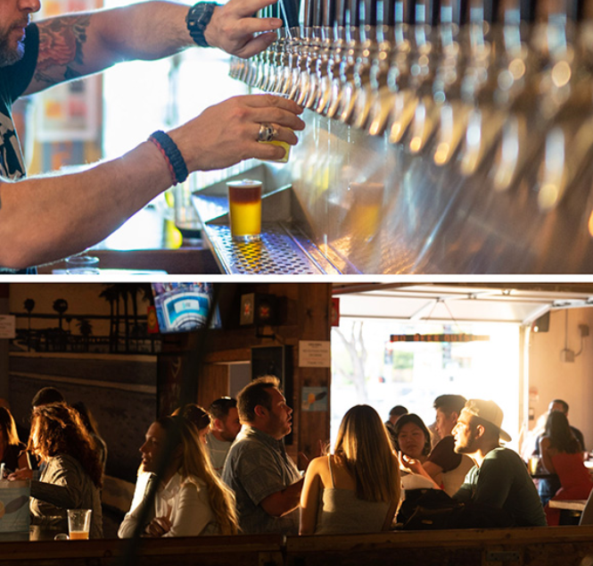
SoCal PDA Networking Event:
Thursday January 26th, | 4 PM - 9 PM
9675 Scranton Rd., San Diego, CA 92121
Drinks and Food Provided. Register at SoCalPDAchapter.org

